Slide 1
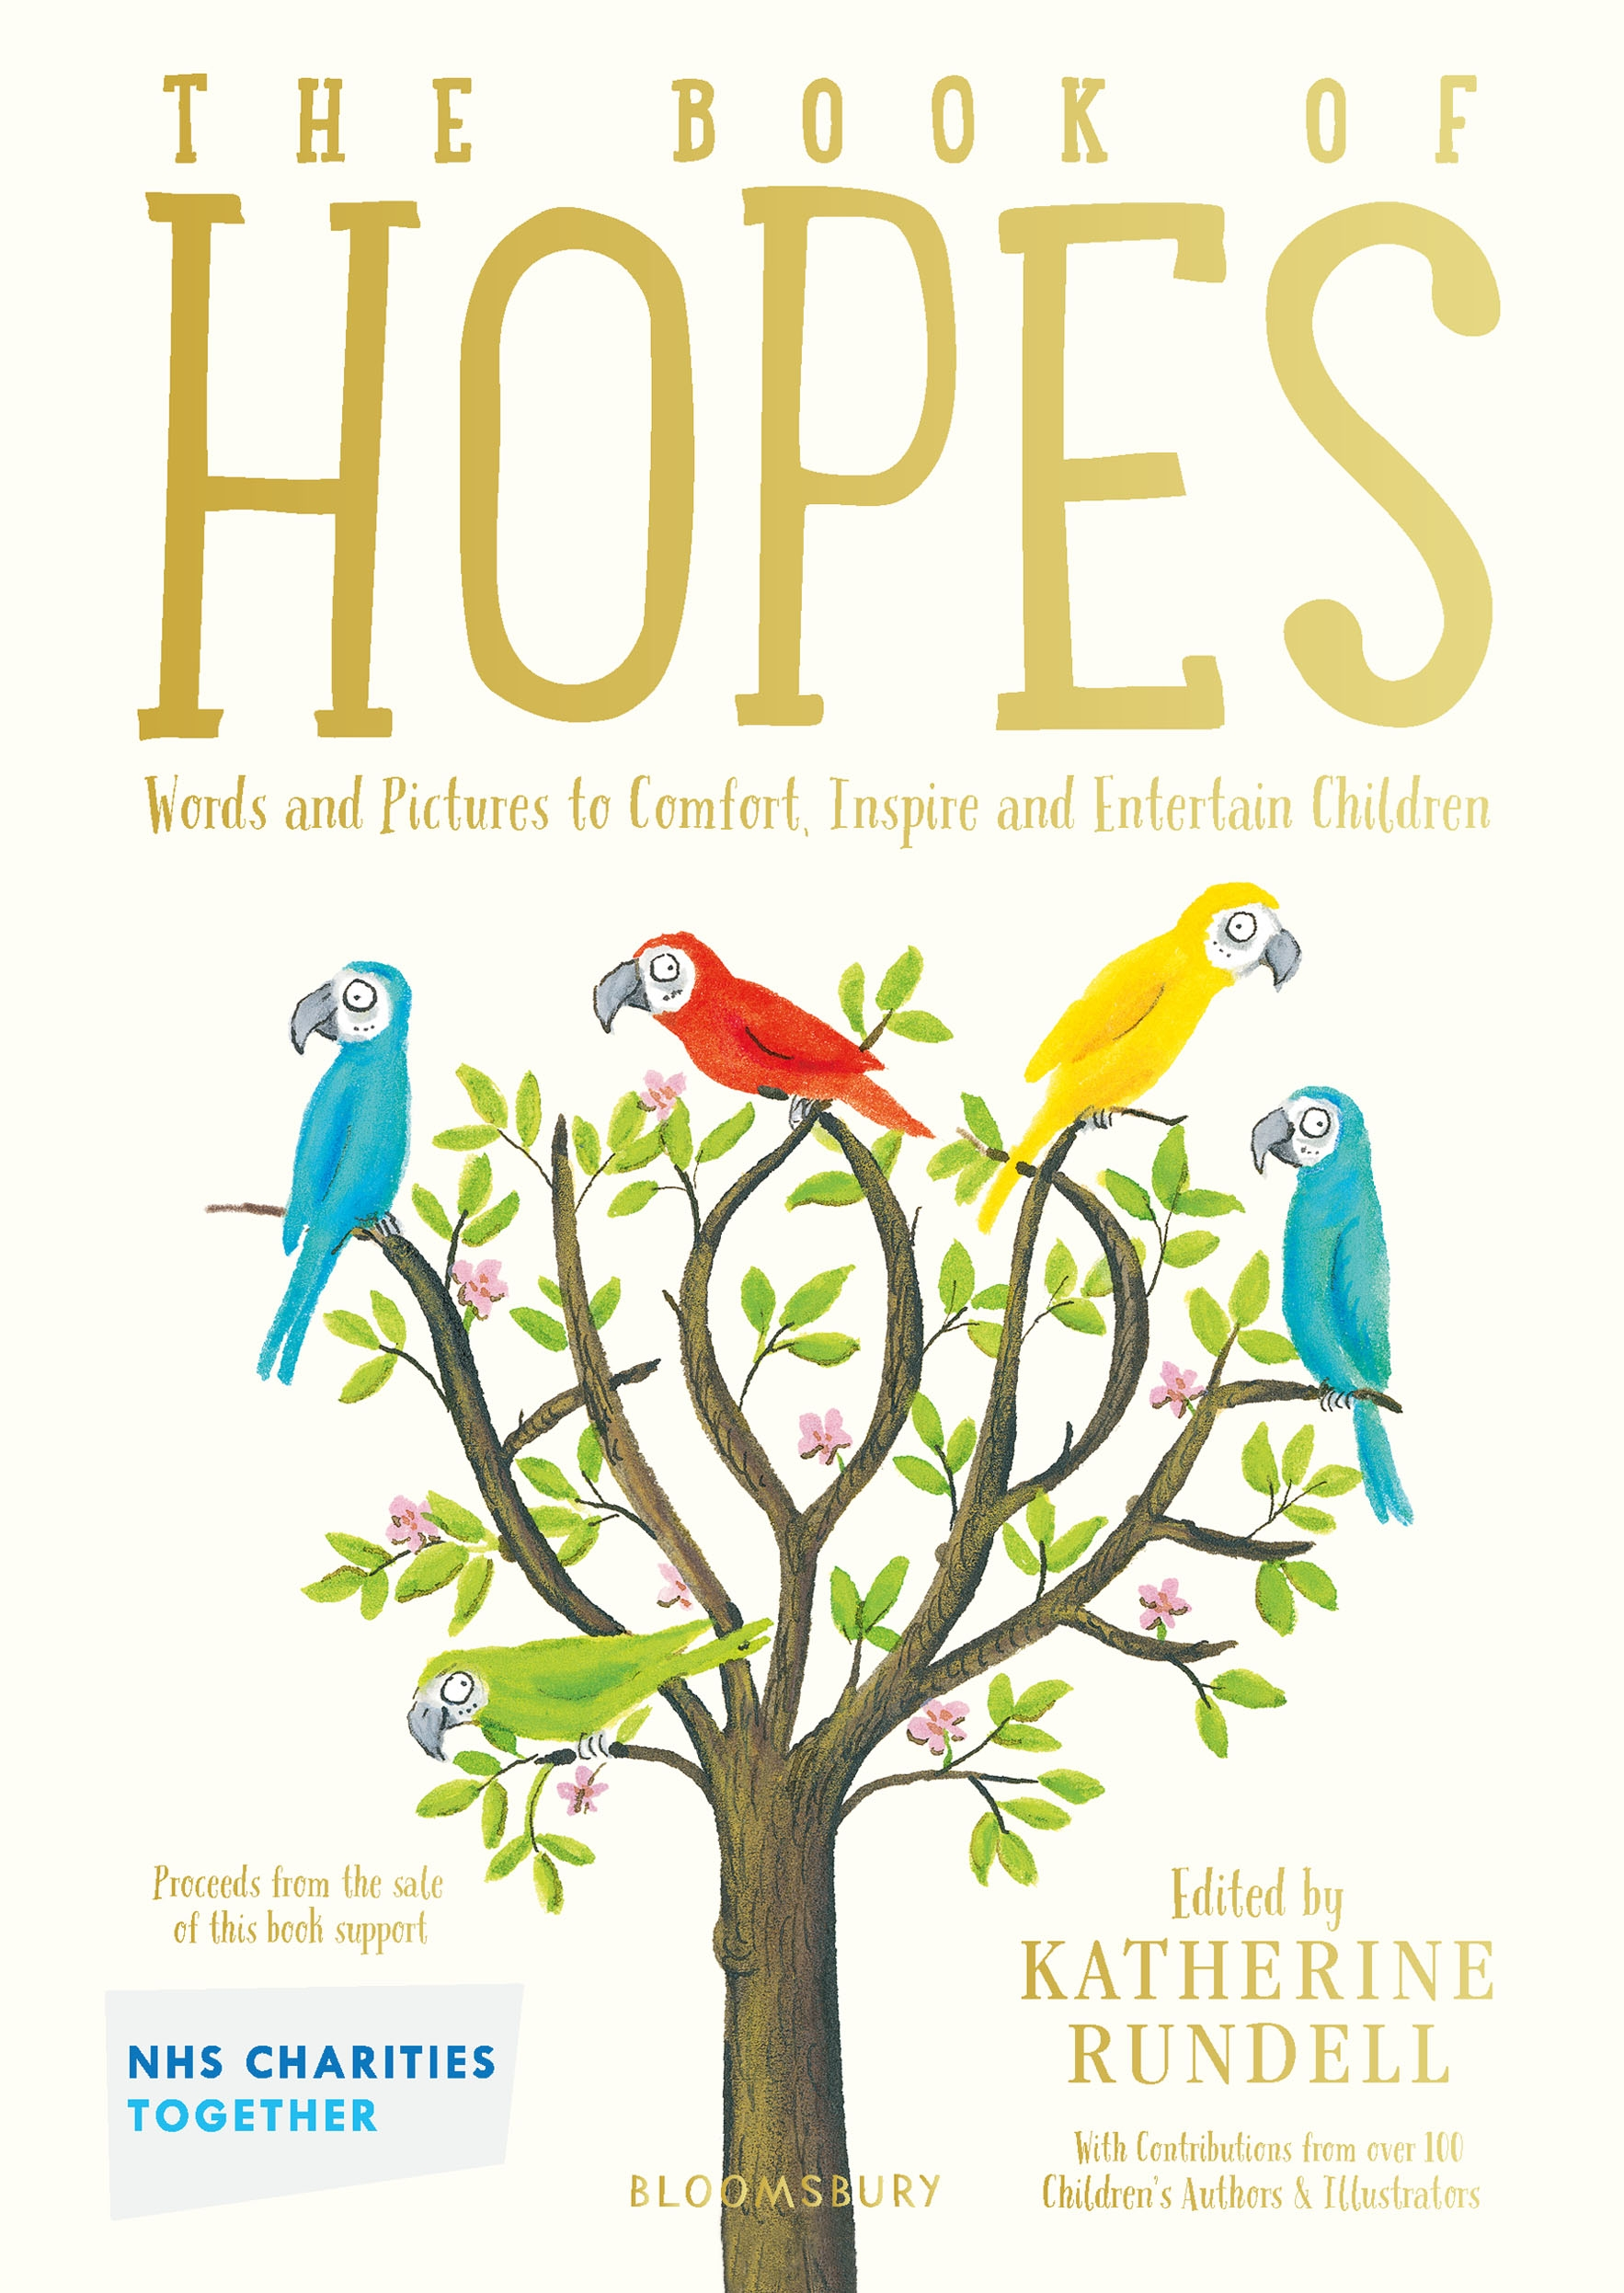
Gratitude
Wellbeing and literacy activities
Key Stage 2
© National Literacy Trust 2020
The Book of Hopes: Words and Pictures to Comfort, Inspire and Entertain Children, edited by Katherine Rundell, published by Bloomsbury Publishing

Slide 2
Gratitude
What does “gratitude” mean?
Gratitude is a feeling of thankfulness for what we have.
Focusing on what we are grateful for can make us feel better when we are going through a difficult time.
© National Literacy Trust 2020
The Book of Hopes: Words and Pictures to Comfort, Inspire and Entertain Children, edited by Katherine Rundell, published by Bloomsbury Publishing

Slide 3
Gratitude
Why is it important to focus on the good things in our lives?
How might this help us when times are tough?
Is it always easy to be grateful?
© National Literacy Trust 2020
The Book of Hopes: Words and Pictures to Comfort, Inspire and Entertain Children, edited by Katherine Rundell, published by Bloomsbury Publishing

Slide 4
Connecting with each other
Was there a time during lockdown when you felt thankful for something?
Is there something you feel thankful for now you are back at school?
© National Literacy Trust 2020
The Book of Hopes: Words and Pictures to Comfort, Inspire and Entertain Children, edited by Katherine Rundell, published by Bloomsbury Publishing

Slide 5
Connecting with each other
How do we show our gratitude?
How does saying “thank you” make you feel?
How does it make others feel?
© National Literacy Trust 2020
The Book of Hopes: Words and Pictures to Comfort, Inspire and Entertain Children, edited by Katherine Rundell, published by Bloomsbury Publishing

Slide 6
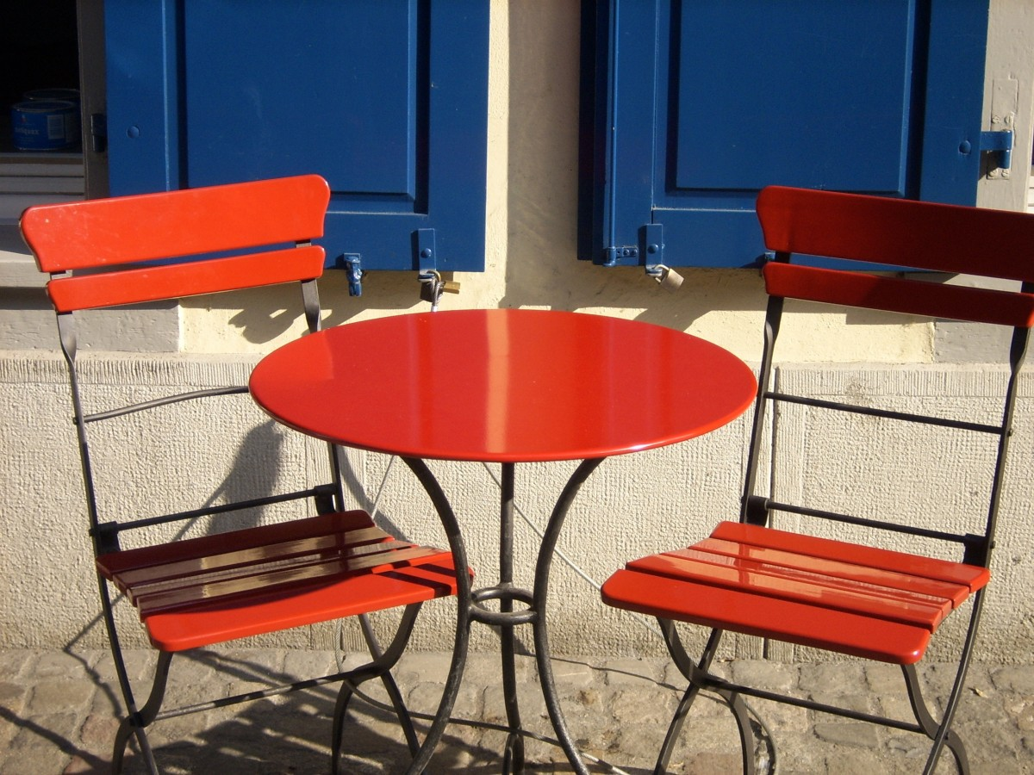
Yasmin and Sila by Marianne Levy
The Book of Hopes
literacytrust.org.uk/bookofhopes
Page 312
© National Literacy Trust 2020
The Book of Hopes: Words and Pictures to Comfort, Inspire and Entertain Children, edited by Katherine Rundell, published by Bloomsbury Publishing

Slide 7
The Best Feeling Ever by Fleur Hitchcock
What was the story about?
Are there any parts you liked?
Were there any pictures in your mind as you heard
the story?
© National Literacy Trust 2020
The Book of Hopes: Words and Pictures to Comfort, Inspire and Entertain Children, edited by Katherine Rundell, published by Bloomsbury Publishing

Slide 8
The Best Feeling Ever by Fleur Hitchcock
How did Yasmin feel at the beginning of the story?
Why had Yasmin been walking for miles and miles?
Where was she coming from?
Why might she have disappeared in the morning?
Where did she go?
© National Literacy Trust 2020
The Book of Hopes: Words and Pictures to Comfort, Inspire and Entertain Children, edited by Katherine Rundell, published by Bloomsbury Publishing

Slide 9
The Best Feeling Ever by Fleur Hitchcock
How did Sila feel about Yasmin to begin with?
What about when she left?
Why did Sila think she would never stop looking for Yasmin?
Who was the other woman sitting in the café at the end of the story?
Why did Yasmin call her daughter Sila?
© National Literacy Trust 2020
The Book of Hopes: Words and Pictures to Comfort, Inspire and Entertain Children, edited by Katherine Rundell, published by Bloomsbury Publishing

Slide 10
Dear Sila, Dear Yasmin
If Sila and Yasmin had been able to write letters to each other, what might they have said?
© National Literacy Trust 2020
The Book of Hopes: Words and Pictures to Comfort, Inspire and Entertain Children, edited by Katherine Rundell, published by Bloomsbury Publishing

Slide 11
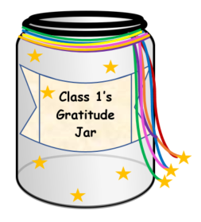
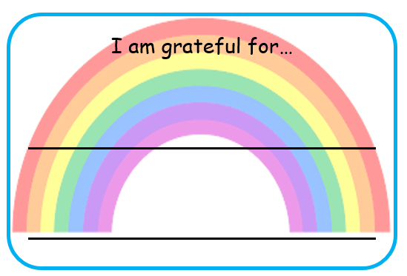
Gratitude jar
© National Literacy Trust 2020
The Book of Hopes: Words and Pictures to Comfort, Inspire and Entertain Children, edited by Katherine Rundell, published by Bloomsbury Publishing

