Slide 1
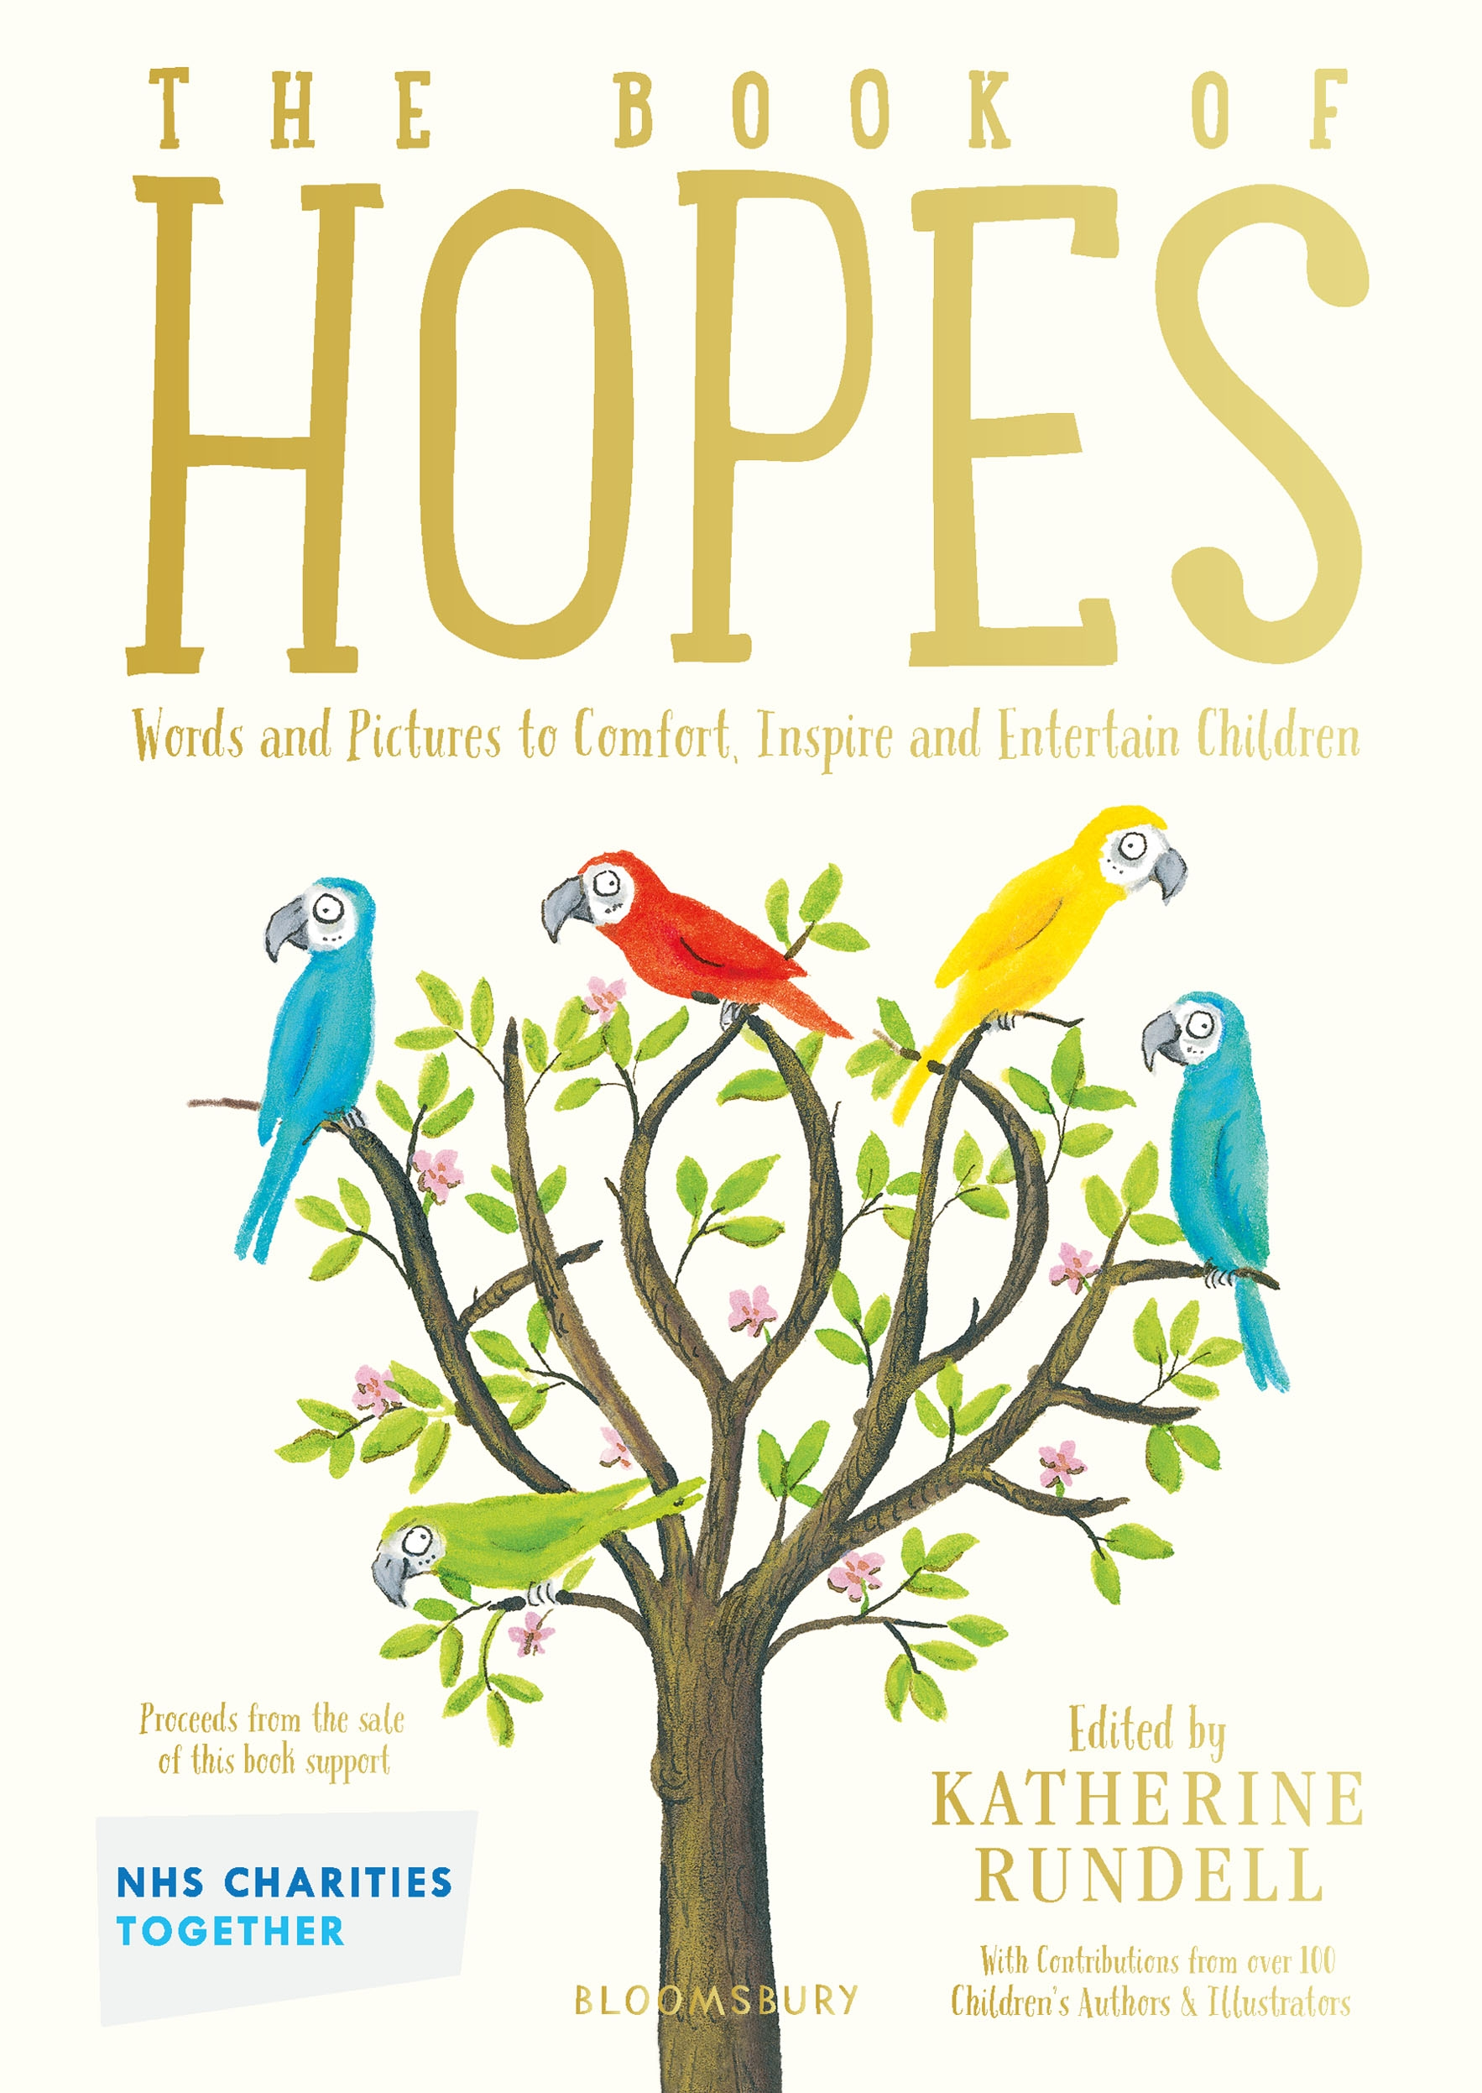
Connectedness
Wellbeing and literacy activities
Key Stage 2
© National Literacy Trust 2020
The Book of Hopes: Words and Pictures to Comfort, Inspire and Entertain Children, edited by Katherine Rundell, published by Bloomsbury Publishing

Slide 2
Connecting with each other
What do we mean when we talk about “connecting” with someone?
Can anyone give an example of how they connect with a friend? How about a family member?
Why is connecting with each other important?
© National Literacy Trust 2020
The Book of Hopes: Words and Pictures to Comfort, Inspire and Entertain Children, edited by Katherine Rundell, published by Bloomsbury Publishing

Slide 3
Connecting with each other
How did it feel during lockdown when you couldn’t see your friends?
Did you find other ways of connecting with people when you couldn’t see them?
How does it feel to connect with each other now we are back at school?
© National Literacy Trust 2020
The Book of Hopes: Words and Pictures to Comfort, Inspire and Entertain Children, edited by Katherine Rundell, published by Bloomsbury Publishing

Slide 4
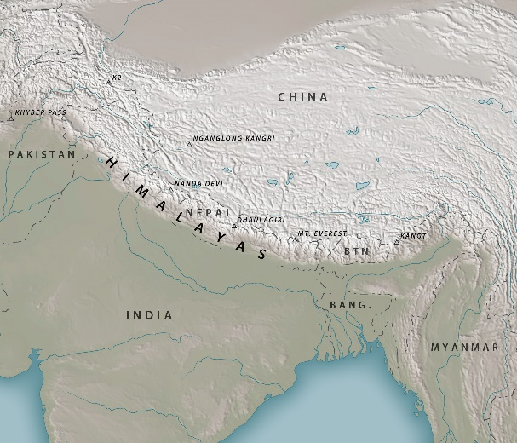
The Lamagaia Nest by Jasbinder Bilan
The Book of Hopes
literacytrust.org.uk/bookofhopes
Page 80
© National Literacy Trust 2020
The Book of Hopes: Words and Pictures to Comfort, Inspire and Entertain Children, edited by Katherine Rundell, published by Bloomsbury Publishing

Slide 5
The Lamagaia Nest by Jasbinder Bilan
What was the story about?
Are there any parts you particularly liked?
Where is the story set?
How does the writer describe the landscape?
© National Literacy Trust 2020
The Book of Hopes: Words and Pictures to Comfort, Inspire and Entertain Children, edited by Katherine Rundell, published by Bloomsbury Publishing

Slide 6
The Lamagaia Nest by Jasbinder Bilan
Are there any words from other languages?
Can anyone translate or guess their meaning?
What do you think a lamagaia bird looks like?
© National Literacy Trust 2020
The Book of Hopes: Words and Pictures to Comfort, Inspire and Entertain Children, edited by Katherine Rundell, published by Bloomsbury Publishing

Slide 7
The Lamagaia Nest by Jasbinder Bilan
What is Asha’s relationship with Nanijee like?
How can we tell that Nanijee and Asha are close and connected?
What does Nanijee mean when she says that she will always be with Asha?
Do the characters in the story remind you of anyone you know?
What do you think might happen next in the story?
© National Literacy Trust 2020
The Book of Hopes: Words and Pictures to Comfort, Inspire and Entertain Children, edited by Katherine Rundell, published by Bloomsbury Publishing

Slide 8
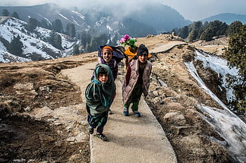
The Lamagaia Nest by Jasbinder Bilan
Himalaya
A large mountain range in Asia with over fifty mountains, including Mount Everest.
The name “Himalaya” comes from ancient Sanskrit:
Himá ( हिम ) = snow
ā-laya ( आलय ) = abode or dwelling.
© National Literacy Trust 2020
The Book of Hopes: Words and Pictures to Comfort, Inspire and Entertain Children, edited by Katherine Rundell, published by Bloomsbury Publishing

Slide 9
The Lamagaia Nest by Jasbinder Bilan
Nanijee
Grandmother
What other words can you think of that mean “grandmother”?
© National Literacy Trust 2020
The Book of Hopes: Words and Pictures to Comfort, Inspire and Entertain Children, edited by Katherine Rundell, published by Bloomsbury Publishing

Slide 10
The Lamagaia Nest by Jasbinder Bilan
Ajwain
a seed-like fruit that tastes a bit like aniseed or caraway. Also known as carom.
Does your family cook with anything similar to this?
Does your family have any dishes from your culture that they cook at home?
What does your family eat on special occasions?
© National Literacy Trust 2020
The Book of Hopes: Words and Pictures to Comfort, Inspire and Entertain Children, edited by Katherine Rundell, published by Bloomsbury Publishing

Slide 11
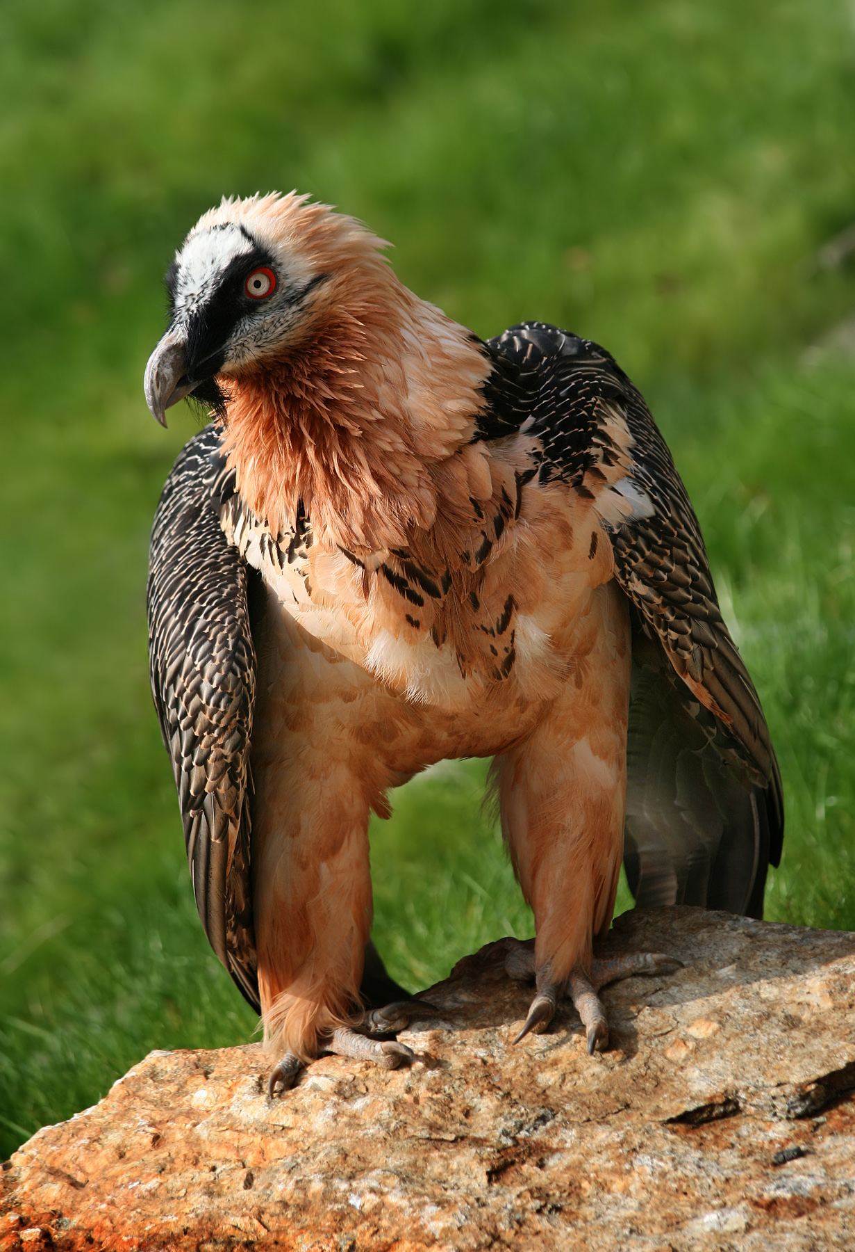
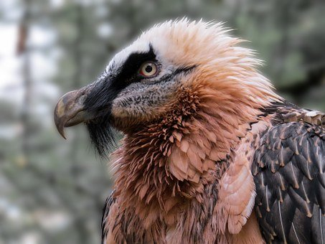
The Lamagaia Nest by Jasbinder Bilan
Lamagaia
a bearded vulture
What other stories or superstitions have birds in them?
What do birds represent in these stories?
What might the Lamagaia bird represent to Asha and Nanijee?
© National Literacy Trust 2020
The Book of Hopes: Words and Pictures to Comfort, Inspire and Entertain Children, edited by Katherine Rundell, published by Bloomsbury Publishing

Slide 12
The Lamagaia Nest by Jasbinder Bilan
Which religions are practiced in India?
Hinduism
Islam
Christianity
Buddhism
Sikhism
© National Literacy Trust 2020
The Book of Hopes: Words and Pictures to Comfort, Inspire and Entertain Children, edited by Katherine Rundell, published by Bloomsbury Publishing

Slide 13
The Lamagaia Nest by Jasbinder Bilan
© National Literacy Trust 2020
The Book of Hopes: Words and Pictures to Comfort, Inspire and Entertain Children, edited by Katherine Rundell, published by Bloomsbury Publishing

Slide 14
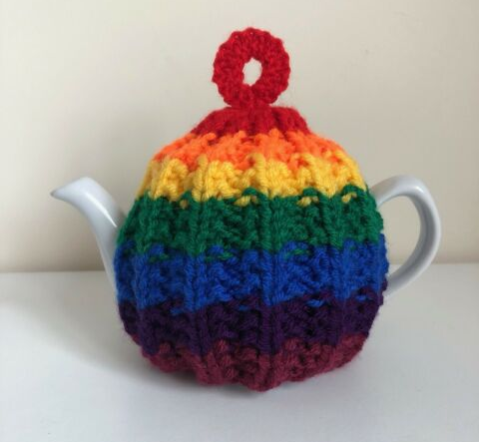
The Gift of Time
by Sita Brahmachari
The Book of Hopes
literacytrust.org.uk/bookofhopes
Page 157
© National Literacy Trust 2020
The Book of Hopes: Words and Pictures to Comfort, Inspire and Entertain Children, edited by Katherine Rundell, published by Bloomsbury Publishing

Slide 15
The Gift of Time
by Sita Brahmachari
What was the story about?
What characters were in the story?
Were there any moments that stood out to you?
What were the characters’ relationships to each other?
© National Literacy Trust 2020
The Book of Hopes: Words and Pictures to Comfort, Inspire and Entertain Children, edited by Katherine Rundell, published by Bloomsbury Publishing

Slide 16
The Gift of Time
by Sita Brahmachari
How did young Sita feel at first about the little trips with her father and the visit to Iris’s house?
How can you tell?
Did she feel the same on the drive home?
What about at the end of the story?
© National Literacy Trust 2020
The Book of Hopes: Words and Pictures to Comfort, Inspire and Entertain Children, edited by Katherine Rundell, published by Bloomsbury Publishing

Slide 17
The Gift of Time
by Sita Brahmachari
What was Iris’s life like? Are there clues in the text?
What does the title of the story mean?
Why was that story important to Sita and why does she remember it all these years later?
© National Literacy Trust 2020
The Book of Hopes: Words and Pictures to Comfort, Inspire and Entertain Children, edited by Katherine Rundell, published by Bloomsbury Publishing

Slide 18
The Gift of Time
by Sita Brahmachari
My dear new friend…
© National Literacy Trust 2020
The Book of Hopes: Words and Pictures to Comfort, Inspire and Entertain Children, edited by Katherine Rundell, published by Bloomsbury Publishing

Slide 19
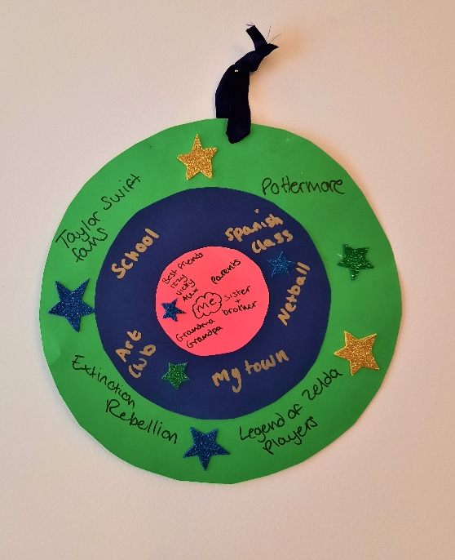
The Gift of Time
by Sita Brahmachari
Community circles
Smallest circle: Your closest friends and family members
Medium circle: Your local communities
Largest circle: Your global communities
© National Literacy Trust 2020
The Book of Hopes: Words and Pictures to Comfort, Inspire and Entertain Children, edited by Katherine Rundell, published by Bloomsbury Publishing

Slide 20
?
Asking for help
© National Literacy Trust 2020
The Book of Hopes: Words and Pictures to Comfort, Inspire and Entertain Children, edited by Katherine Rundell, published by Bloomsbury Publishing

Slide 21
…
Alone time
© National Literacy Trust 2020
The Book of Hopes: Words and Pictures to Comfort, Inspire and Entertain Children, edited by Katherine Rundell, published by Bloomsbury Publishing

